Slide 1
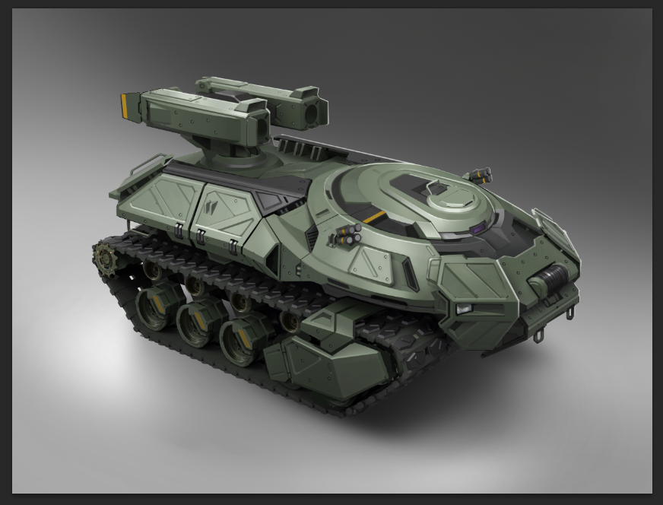
Dr. Doom Preliminary Design Review
4-12-2017

Slide 2
Technical
Project Overview
High Level Block Diagram [system architecture]
Subsystem Slides [include block diagrams and/or analysis]
Sensors
SW/FW
Algorithm
GUI
Design Considerations [why should the customer pick you]
Motion accuracy
Slick GUI
Detailed Budgeting
Other creative design approaches [virtual run through?]
Technical Risk Register
Test Plan Overview

Slide 3
Project Management
Configuration Management
Business Organization [who does what]
Program Risk Register
Cost
Schedule
Cost/Schedule Requirement Drivers
Open Issues
Yell at customer for having too many TBDs

Slide 4
Backup Slides/Documents
VCRM
Task List
Requirements Doc
* Be ready to pull up these docs to answer detailed questions

